Slide 1
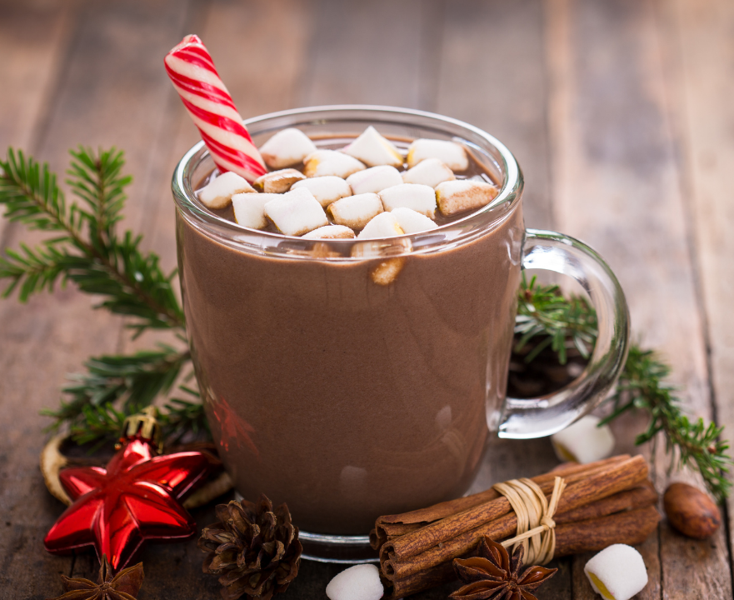
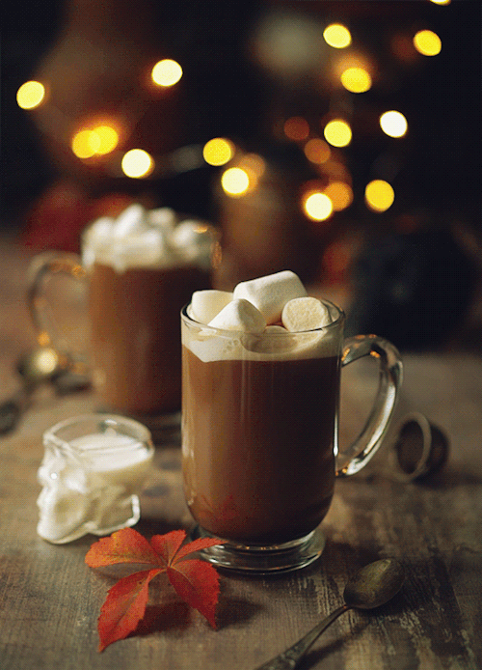


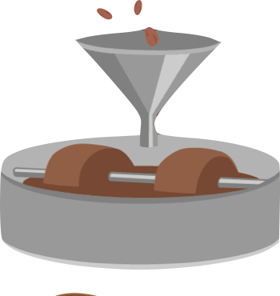




Welcome To The
Chocolate Module
Production
Taste
Where Chocolate Is Produced

Slide 2

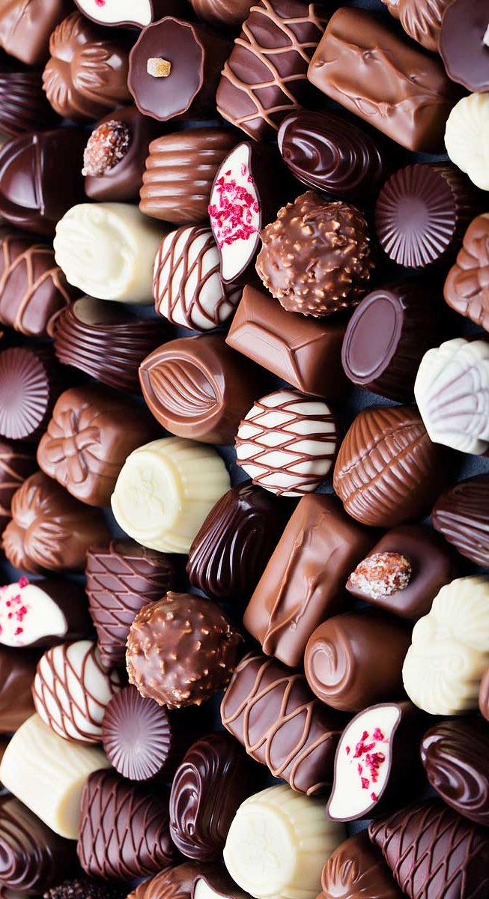
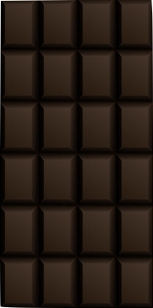
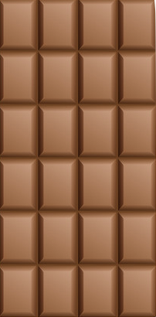
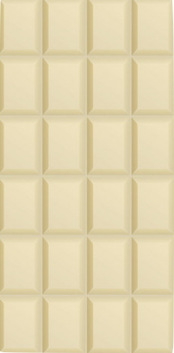


AROMAS AND
TASING NOTES
Chocolate has different styles of flavour, along with appearance, aroma and mouth feel.
We’ve seen new flavours appear throughout the years, including mint flavoured chocolate bars. However, There are only three main types of chocolate:
Dark Chocolate - Bitter, roasted, fruity, earthy and/or nutty notes. The aftertaste can be bitter, intentionally so.
Milk Chocolate - Brown sugar, milk, cream, cocoa, vanilla, honey, caramel, nutty and/or malt notes. Mouthfeel: smooth, velvety.
DARK CHOCOLATE
MILK CHOCOLATE
WHITE CHOCOLATE
White Chocolate – sweet, milky/buttery, vanilla, caramel and cocoa notes. Mouthfeel: creamy, melting.
Naturally has a more bitter taste than milk chocolate, due to containing more chocolate liquor. Commonly produced with sugar, cocoa butter, cocoa liquor, and (sometimes) vanilla.
Milder & sweeter because it is made with milk and higher sugar content than dark varieties. It also has a smaller quantity of chocolate liquor, therefore meaning fewer flavours and aromas.
White chocolate doesn’t actually contains any chocolate liquor. It’s unique flavour is from milk or powdered milk, vanilla and cocoa butter (a type of fat that comes from cocoa beans).

Slide 3
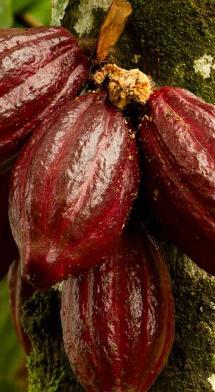
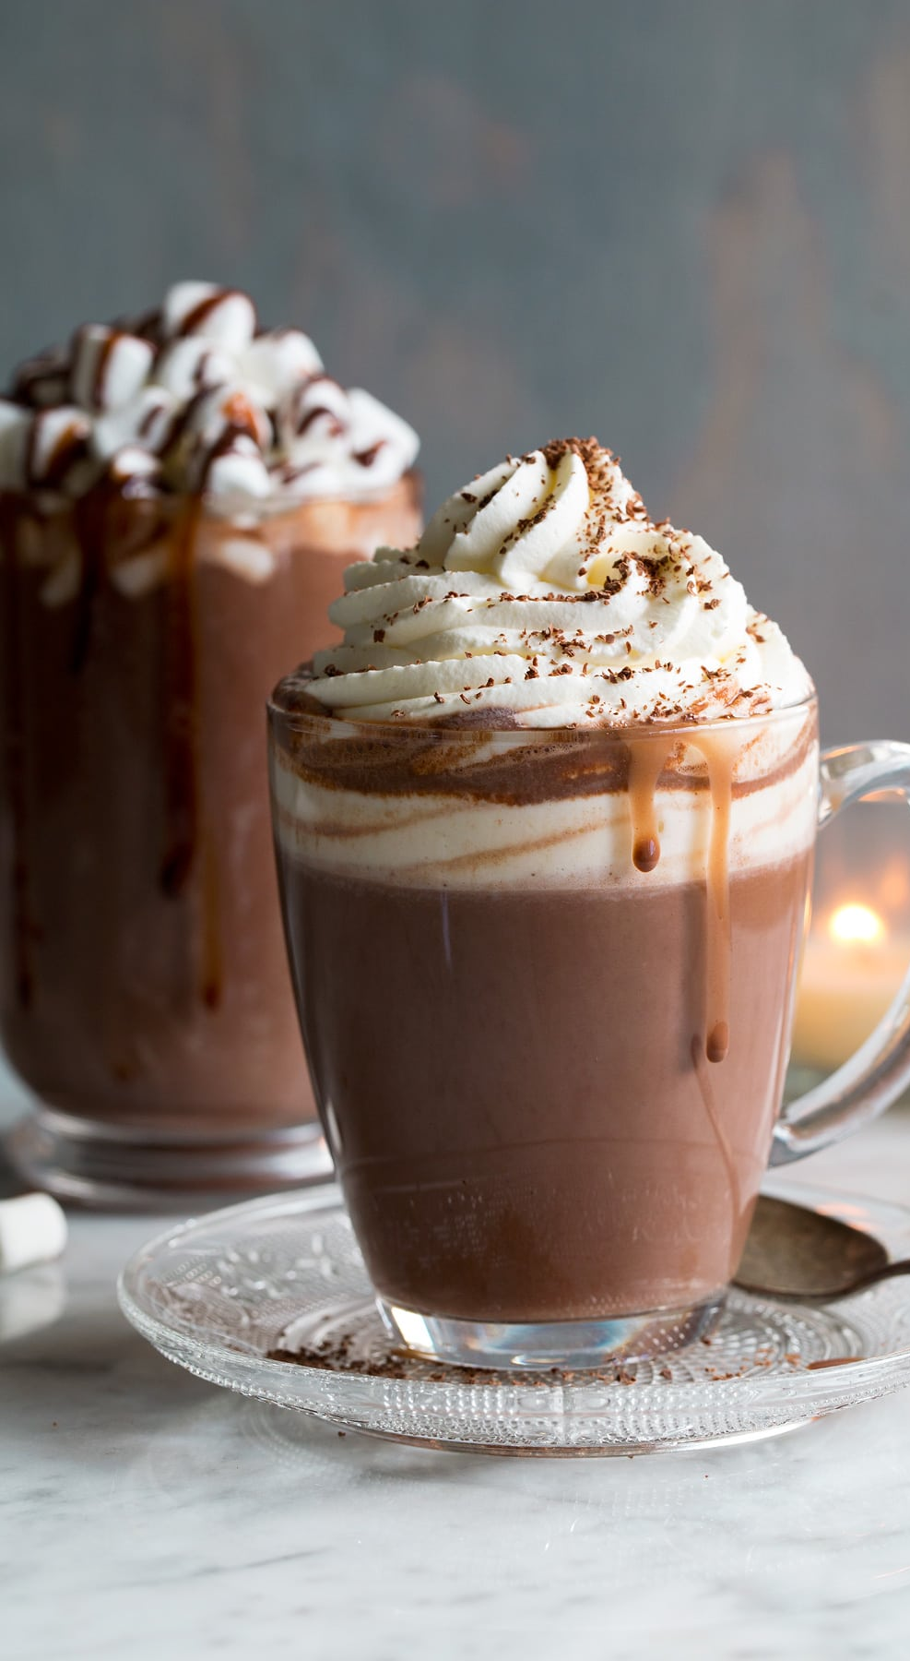
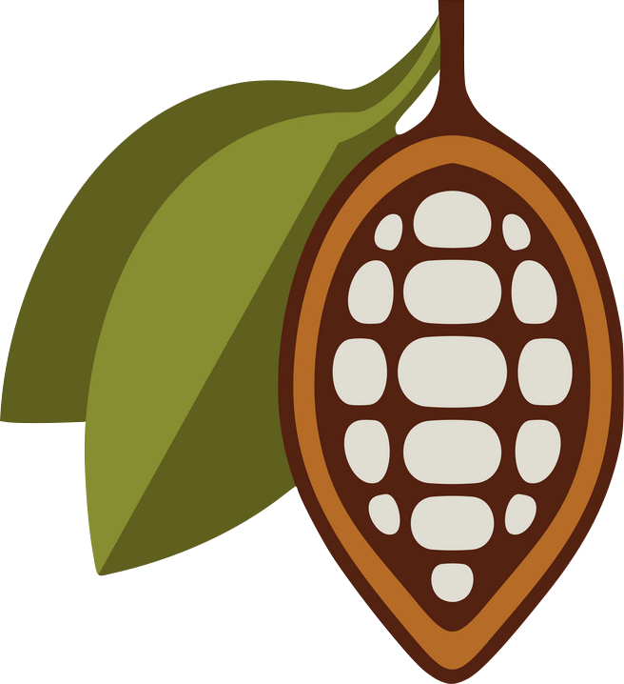
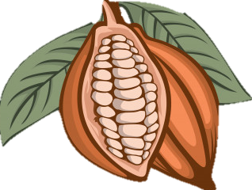
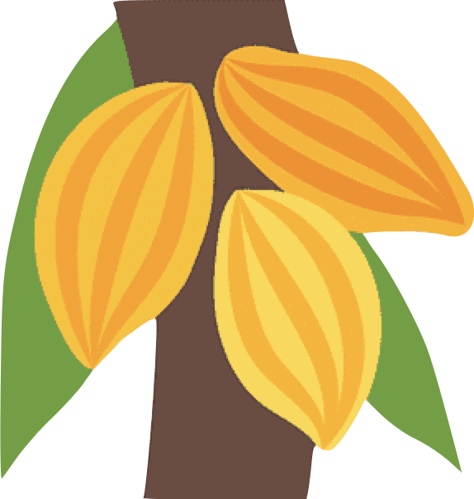
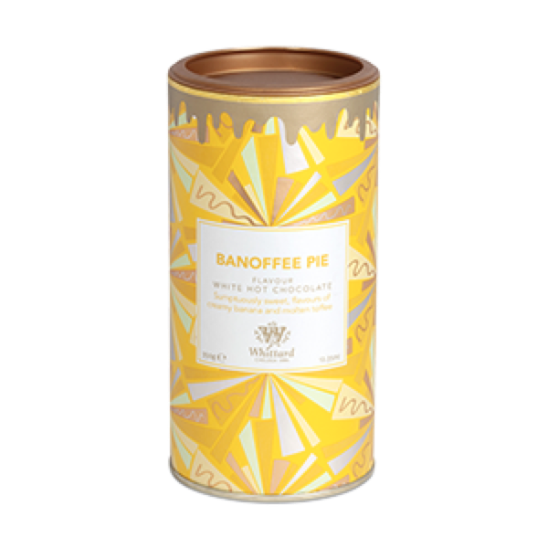
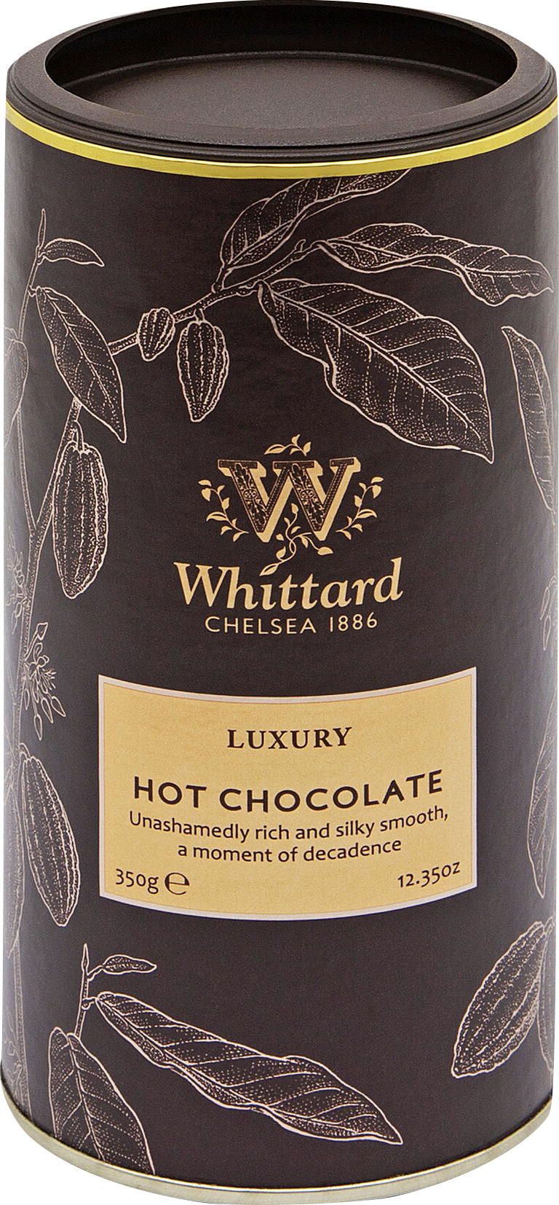
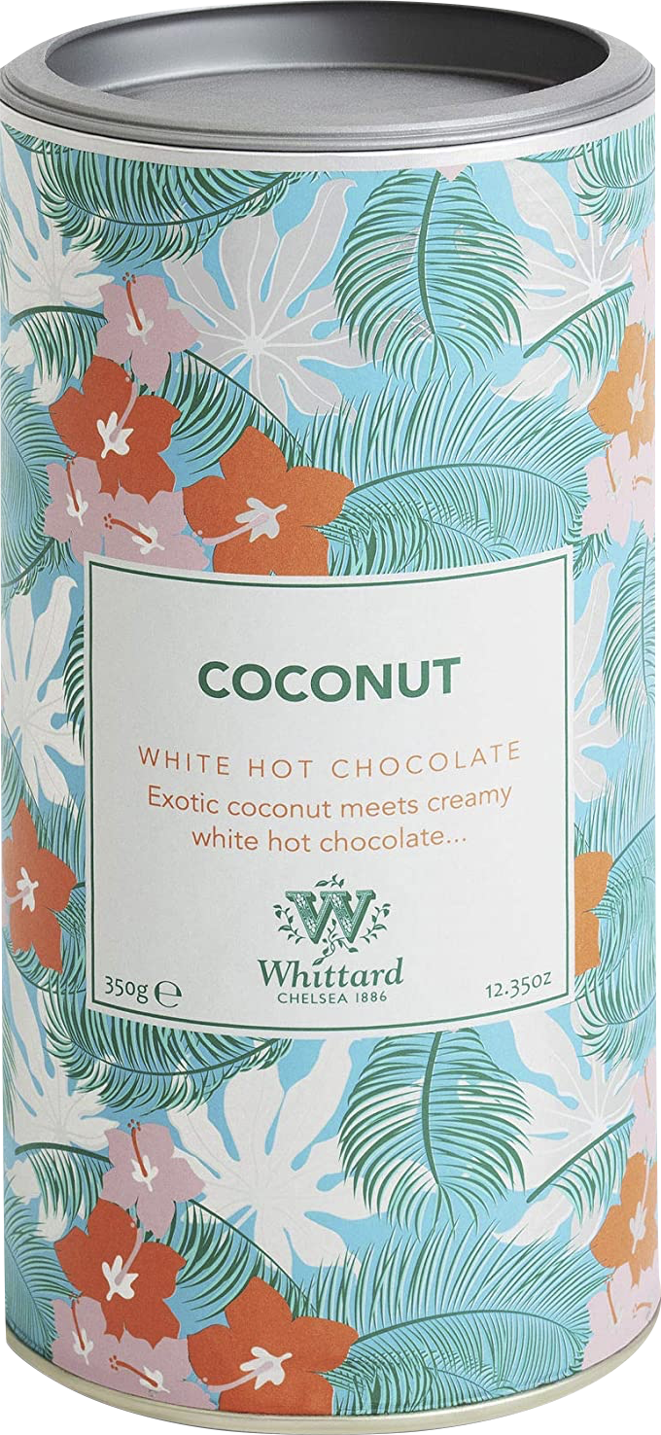
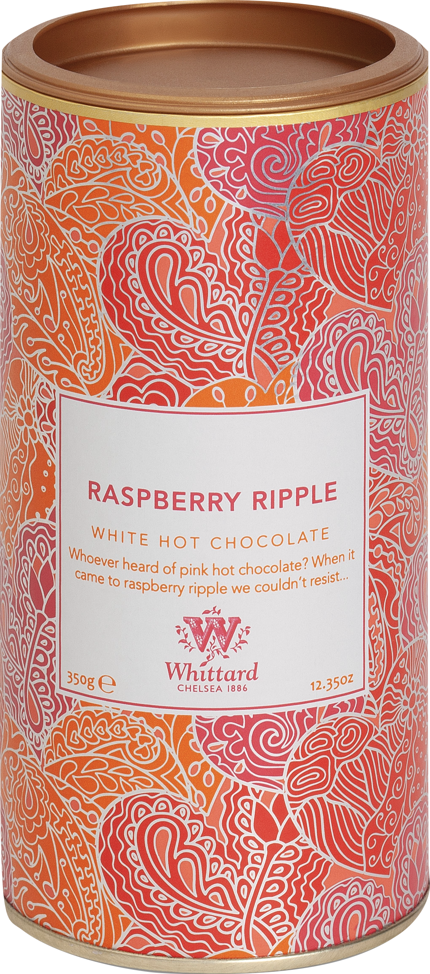


So, we’ve established cacao trees grow cacao pods, so what is inside of them?
Definition:
Hot chocolate is a hot drink made by mixing milk or water with chocolate powder.
Well, inside grows small white beans, around 20 – 50.
Chocolate as you know comes from cocoa beans. However they are only referred to as cocoa, once the beans have been roasted. Before this step, it is known as cacao beans, grown from the cacao tree.
They have a bitter, earthy flavour, like unsweetened dark chocolate, and a crunchy texture like a coffee bean.
Hot chocolate varies in flavour depending on the method used to make the beverage. Hot chocolate has also been re-imagined within the last few years with new flavours such as raspberry and even sticky toffee pudding!
You will soon see the journey the beans undertake, to get to the chocolate we know.

Slide 4

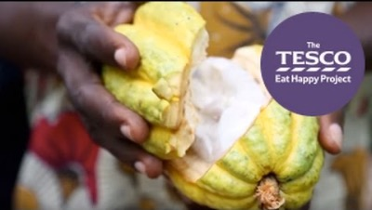
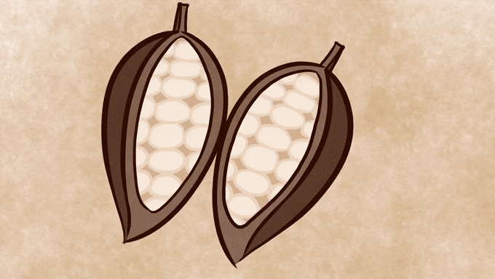
Lets Recap What We’ve Learned So Far…

Slide 5


HISTORY OF CHOCOLATE TIMELINE
Chocolate, derived from the seed of the cacao tree, which was used by the Maya Culture. Maya called the cacao tree ”cacahuaqucht” & the word chocolate comes from the Maya word xocoatl which means bitter water.
Christopher Colombus presents cocoa to the Spanish king.
2000 BC, Amazon
1200 – 1300
1519 - 1528
Sixth Century AD
1492
Cocoa, from which chocolate is created, is said to have originated in the Amazon at least 4,000 years ago.
Mayans begin trade with Aztecs. Chocolate then becomes popular with the Aztecs.
Chocolate is then brought to Spain and Hernan Cortez begins a cocoa plantation.

Slide 6

HISTORY OF CHOCOLATE TIMELINE
Chocolate becomes more widely available in Coffee Houses & Chocolate Houses in London.
Chocolate has found a new form: powdered chocolate.
1585
1800
1847
1600
1828
Chocolate goes to market. Becomes popular in Europe.
Chocolate becomes an industry.
The creation of the first modern chocolate bar is created by Joseph Fry

Slide 7
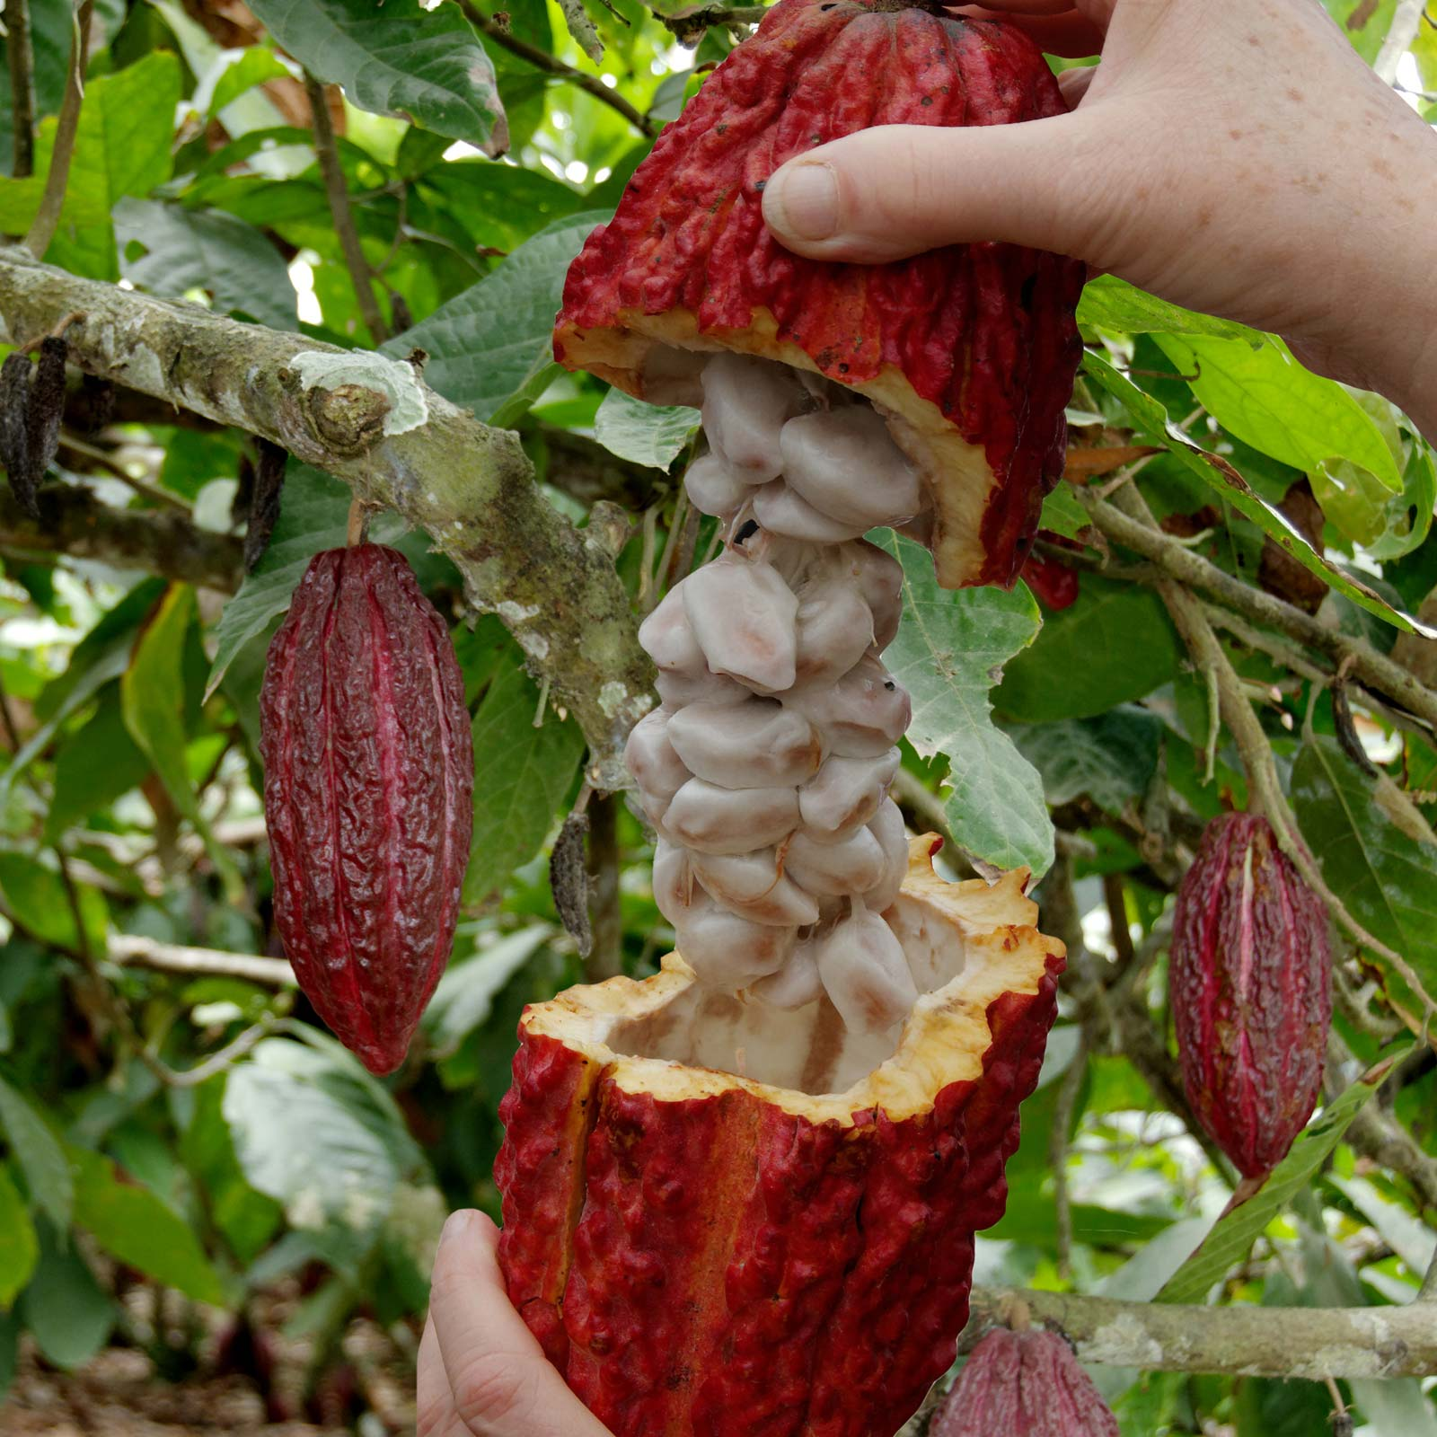
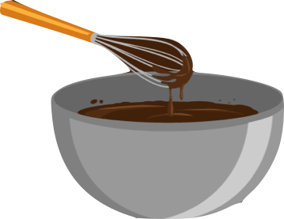
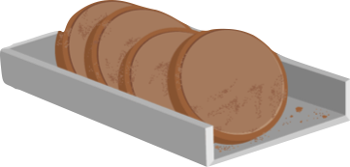
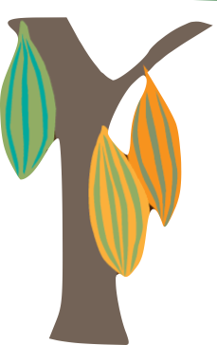

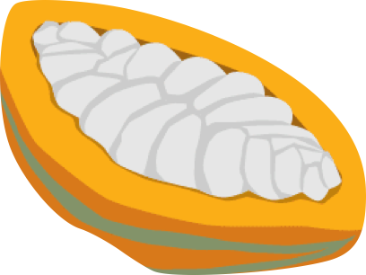
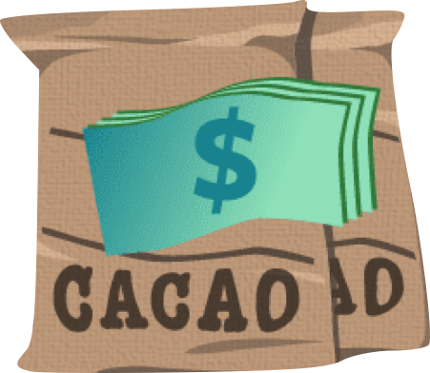

1. Growing
MILLIONS OF FARMERS GROW CACAO TREES IN TROPICAL, OFTEN REMOTE ENVIRONMENTS
7. Pressing
PRESSING SEPARATES LIQUOR INTO COCOA BUTTER AND COCOA CAKES, COCOA CAKES CAN BE SOLD AS IS OR GROUND INTO A FINE POWDER
8. Chocolate Making
COCOA LIQUOR IS MIXED WITH COCOA BUTTER, SUGAR, AND IN SOME CASES MILK. THIS CAN THEN BE MOULDED AND SOLD IN MANY WAYS
2. Harvesting
FARMERS HARVEST TYPICALLY 20-50 BEANS PER CACAO POD
5. Packing & Transporting
BEANS ARE LOADED ONTO SHIPS, TRANSPORTING THEM AROUND THE WORLD. THE COCOA IS STORED UNTIL REQUESTED BY THE PROCESSOR OR MANUFACTURER.
3. Fermenting & Drying
6. Roasting & Grinding
BEANS ARE REMOVED FROM PODS, THE NATURAL LAYER OF PULP AROUND THE BEAN HEATS UP AND FERMENTS. BEANS ARE THEN DRIED AND REFERRED TO AS COCOA BEANS
BEANS ARE SHELLED AND ROASTED, THEN THE INSIDE OF THE BEAN IS GROUNDED INTO A PASTE. THE HEAT MELTS THE COCOA BUTTER INTO A “COCOA LIQUOR”
4. Marketing
FARMERS SELL THE BEANS TO AGENTS, WHO BRING THE PRODUCT TO AN EXPORTING COMPANY

Slide 8







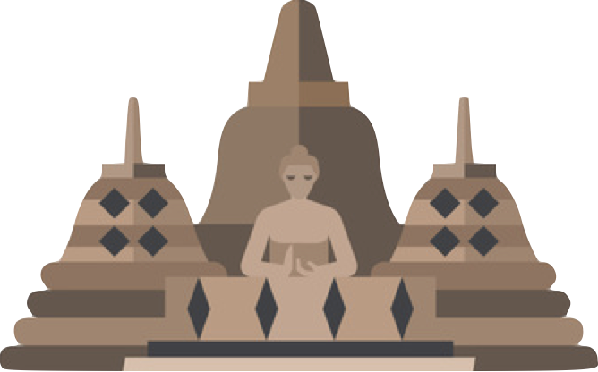

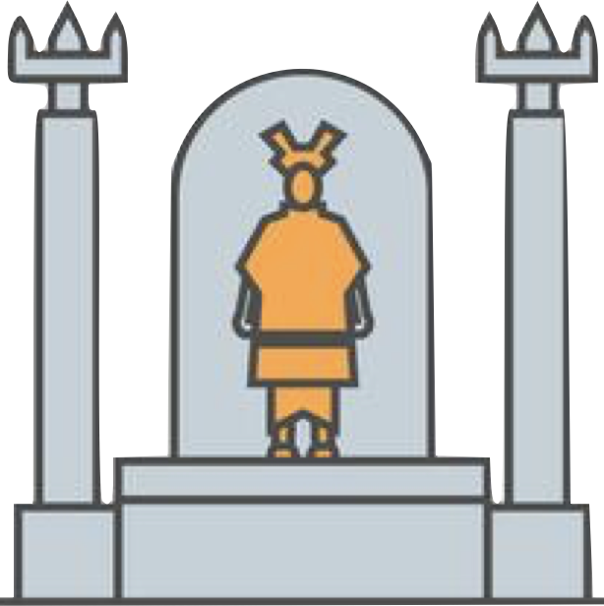


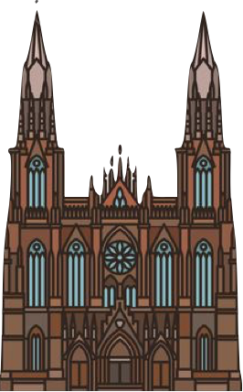

ECUADOR
Ecuador produces only 4% of the worlds cocoa, however the country is responsible for 70% of the worlds fine upper class cocoa.
BRAZIL
Currently Brazil produces on average 350 thousand tons of cocoa per year, of which 90% is destined for exports and the remaining 10% for the Brazilian chocolate industries.
IVORY COAST
Ivory coast are the largest producers of cocoa. In 2016 The Ivory Coast alone produced approximately 1.6 million metric tons of cocoa beans.
The production of cocoa begins in the tropical regions around the Equator, where the hot and humid climate is well suited for growing cacao
trees.
INDONESIA
Cocoa cultivation in Indonesia is a relatively new industry. They barely produced any cocoa until the 1980s. By 2009, cocoa production in the country peaked at 849,875 tons.
VENEZUELA
IVORY COAST
CAMEROON
NIGERIA
Nigeria is the world’s fourth-biggest cocoa-producing nation.
Though the country produces over 300,000 tons of cocoa.
INDONESIA
BRAZIL
GHANA
GHANA
ECUADOR
Ghana is the second biggest exporter of cocoa. The country's cocoa production accounts for 30% of its export revenue.
PERU
NIGERIA
PERU
Peru is the world’s ninth largest cocoa producer (roughly 71,175 tons a year) and the world’s largest organic cocoa producer.
CAMEROON
The world’s fifth-largest cocoa producer. Today, 37% of Cameroon’s cultivated soil is dedicated to cocoa farming.
VENEZUELA
Once the world's leading cocoa producer, Venezuela is the cradle of some of the most famous fine aromatic cocoa in the planet.

Slide 9


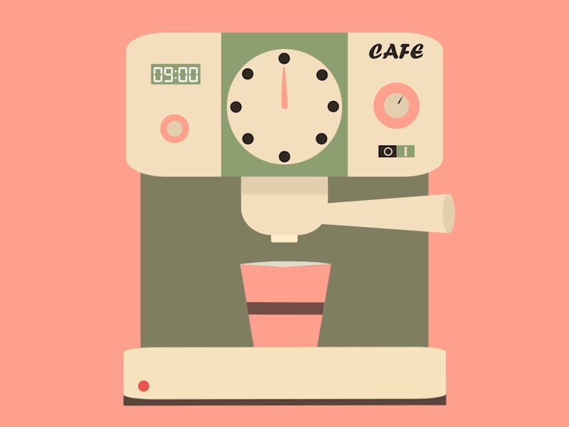

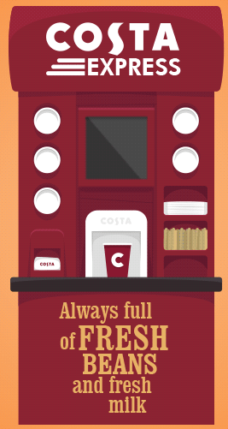
SO WHAT ARE A FEW WAYS OF MAKING HOT CHOCOLATE?
BARISTA MACHINE
HOT WATER OR MILK
SERVICE MACHINES
HOT CHOCOLATE CAN BE MADE WITH THIS MACHINE, USING THE STEAM WAND TO FOAM THE MILK AND THE CHOCOLATE POWDER. THIS METHOD PRODUCES, SMOOTH, SILKY AND RICH HOT CHOCOLATE.
MANY, ESPECIALLY AT HOME, MAKE HOT CHOCOLATE WITH BOILING HOT WATER OR HEATED MILK, AND MIX IN THE POWDER. THIS IS AN EASY METHOD; HOWEVER, THE TASTE AND TEXTURE IS SUBPAR COMPARED TO THE BARISTA.
THESE AUTOMATIC MACHINES ARE ANOTHER COMMON MAKING METHOD, ITS QUICK AND EASY, TASTES BETTER THAN HOME MAKING, HOWEVER THEY MAY TASTE ARTIFICIAL.

Slide 10
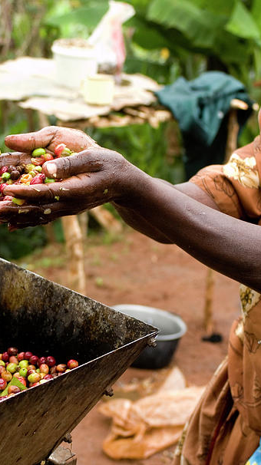


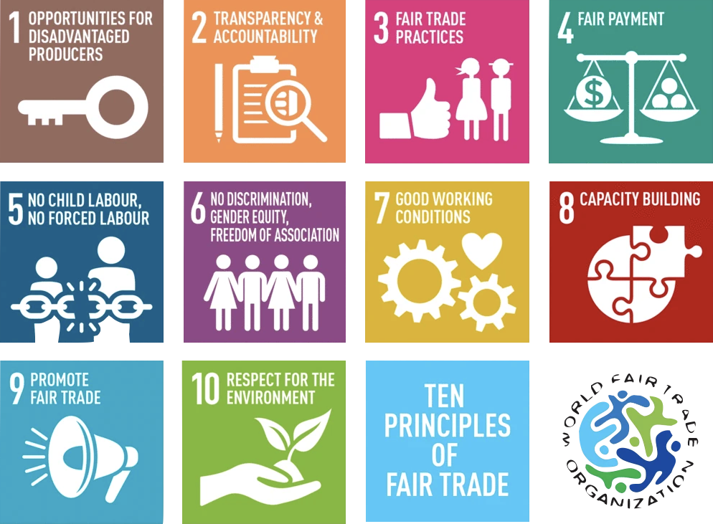

THE 10 PRINCIPLES OF FAIRTRADE
IF A PRODUCT IS FAIRTRADE, YOU WILL SEE THIS LOGO
WHAT IS FAIRTRADE IN THE CHOCOLATE INDUSTRY?
Fairtrade helps to make cocoa farming in places like Ivory Coast and Ghana more sustainable by guaranteeing minimum prices and providing a Fairtrade Premium to invest in local communities, so farmers can provide a better future for themselves and their families.
Every time you choose Fairtrade chocolate, you are supporting farmers and their communities.

Slide 11
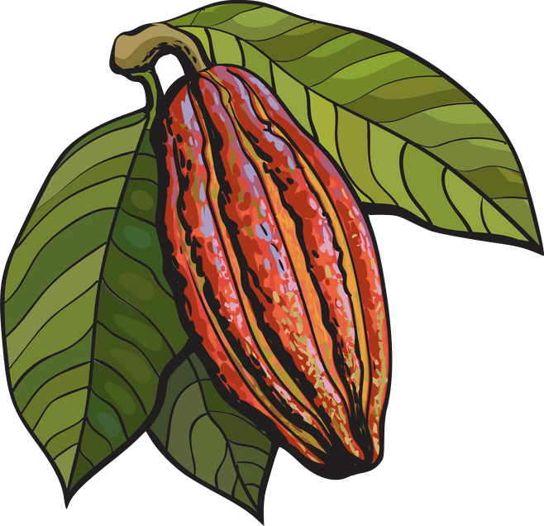
SUMMARY OF HOT CHOC MODULE
What is the History Behind it?
Where does it come from?
Finally, what is Fairtrade?
What is cacao?
What is the process?

