Slide 1
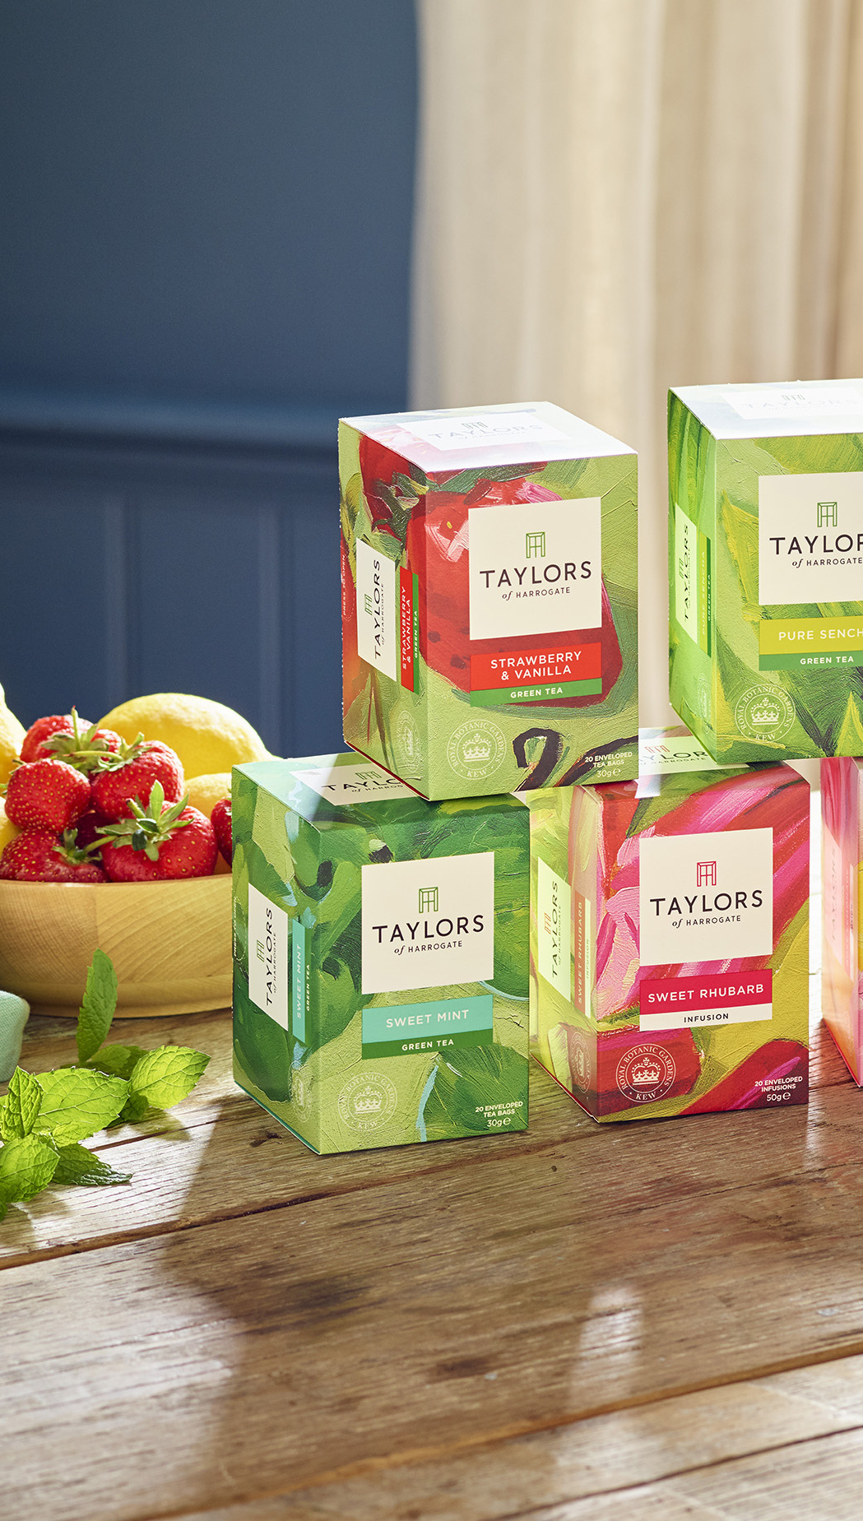





Slide 2
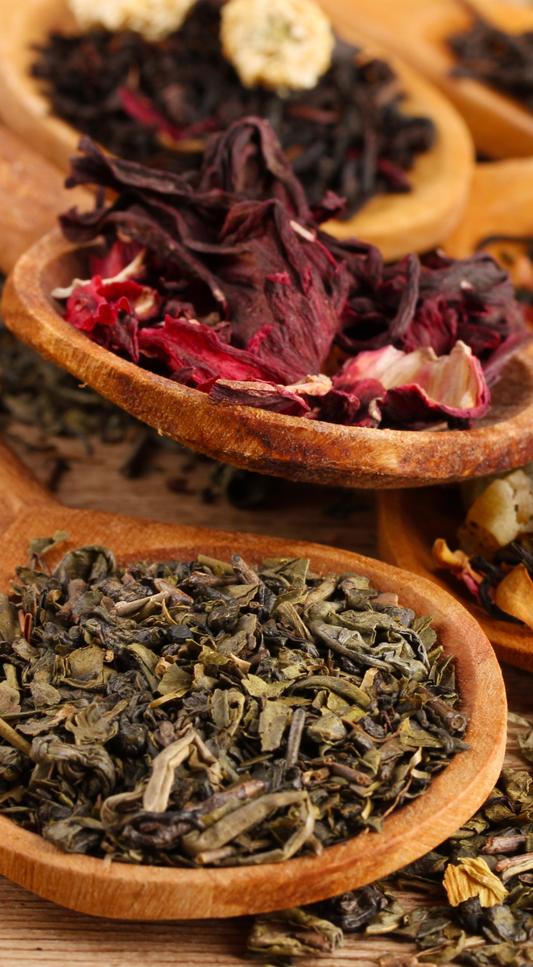
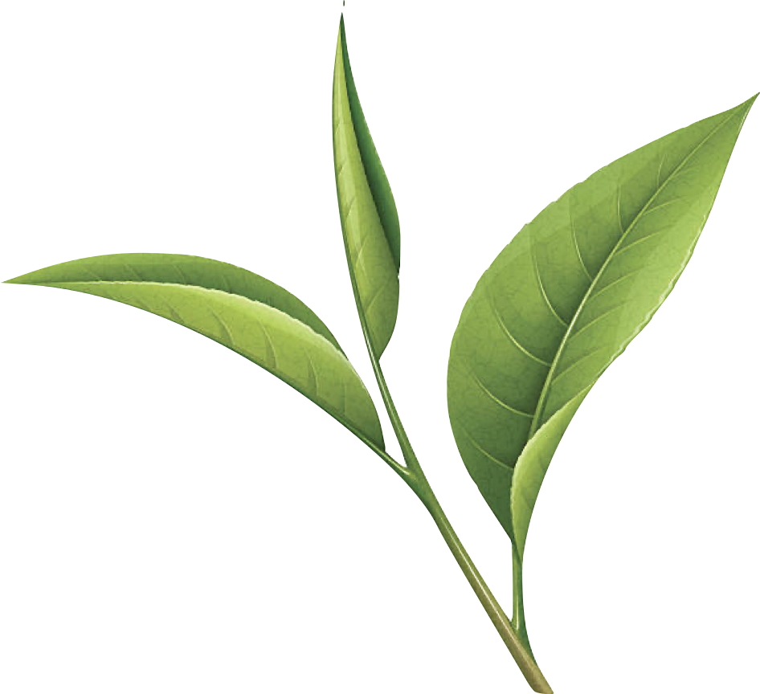
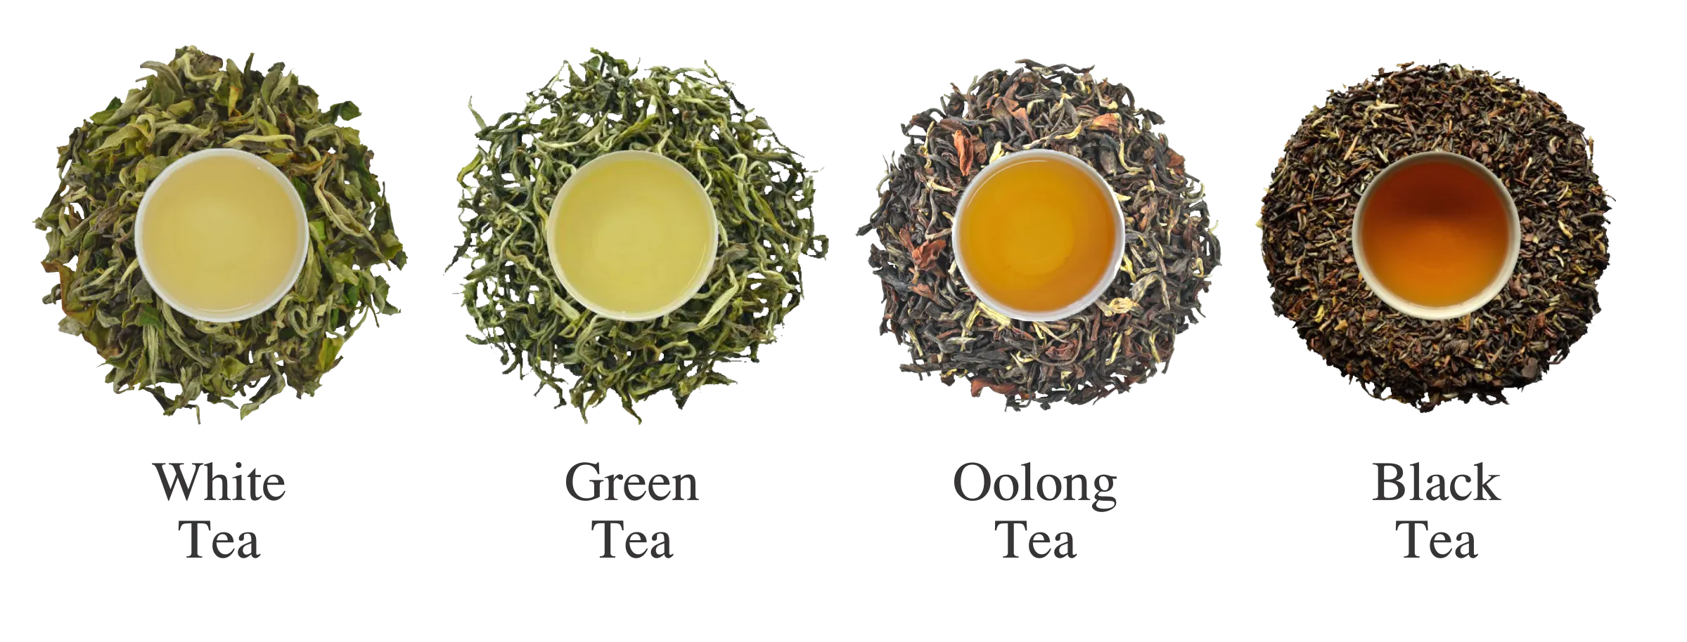

Definition:
Tea is a beverage made by taking leaves from the camellia sinensis plant and steeping them in hot water.
WHITE TEA
GREEN TEA
OOLONG TEA
BLACK TEA

Slide 3
HISTORY OF TEA TIMELINE
In China, tea production evolved, and into different forms and types. Versions ranged from sun dried to steamed green.
The first teapots begin to appear.
2737 BCE
767 CE
1610 AD
350 AD
1391 AD
Discovered by the Chinese Emperor, Shan Nong, A breeze caused a leaf to fall into his cup of hot water. The curious emperor let the leaf steep, then tasted what is now known as ‘tea”.
Tea made its way to Japan late in the sixth century.
The Dutch East India Company imports the first shipments of Chinese tea to Western shores, marketing it to rich people as an exotic medicinal drink.

Slide 4
HISTORY OF TEA TIMELINE
11 million pounds of tea are brought to England.
Tea bags were developed for commercial production, initially from gauze and then later from paper.
1765
1840
TODAY
1785
1920
Tea is ranked as the most popular beverage in the American colonies.
Afternoon tea introduced. Anna the duchess of Bedford introduces afternoon tea, which becomes a lasting English ritual.
Tea is the most widely consumed beverage in the world next to water. China, India and Kenya are the top 3 tea producing countries.

Slide 5





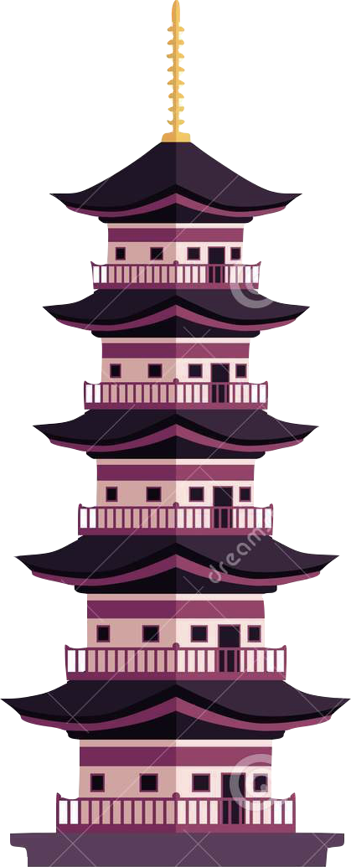








JAPAN
Japan produces around 80,000 tonnes of mostly green tea in the regions of Shizuoka, Kagoshima and Uji.
BRAZIL
Brazil produces 1.530 metric tons of raw leaves per year. They mainly produce green tea, white tea and organic green tea. The majority of the production is exported.
TURKEY
Turkey grows 250,000 tonnes of tea. Notably, they grow Riza a form of black tea.
TURKEY
Today tea is cultivated all over the world, primarily in Asia and Africa, however it’s commercially produced by more than 60 countries. Here’s a list of the top 10 tea producing countries in the world with a description of how they differ.
CHINA
INDONESIA
JAPAN
Indonesia produces 144,000 tonnes of tea annually, mostly black and green teas from Indian Assam varieties.
INDIA
VIETNAM
INDIA
SRI LANKA
India produces 1.25 million tonnes of tea, the world’s second largest producer of tea, grown in across Darjeeling, Nilgiri and Assam.
BRAZIL
INDONESIA
ARGENTINA
Argentina produces just under 90,000 tonnes of tea. They primarily produce black tea varieties of Indian origin.
KENYA
CHINA
China is the world’s largest tea producing country, producing 40% of the world. primarily growing Lapsang Souchong, in the provinces of Yunnan, Guangdong, and Zhejiang.
ARGENTINA
KENYA
Kenya harvests just under 500,000 tonnes of tea each year. Kenya claims the record of the world’s top black tea producing country.
SRI LANKA
Sri Lanka, produces just under 350,000 tonnes of tea, including black teas like Dimbula, Kenilworth and Uva

Slide 6


How Is Tea Produced?

Slide 7
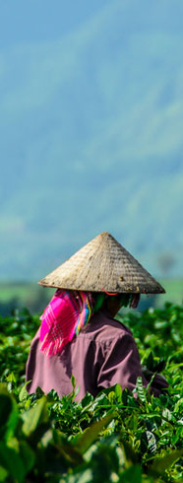

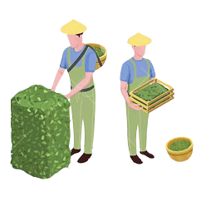

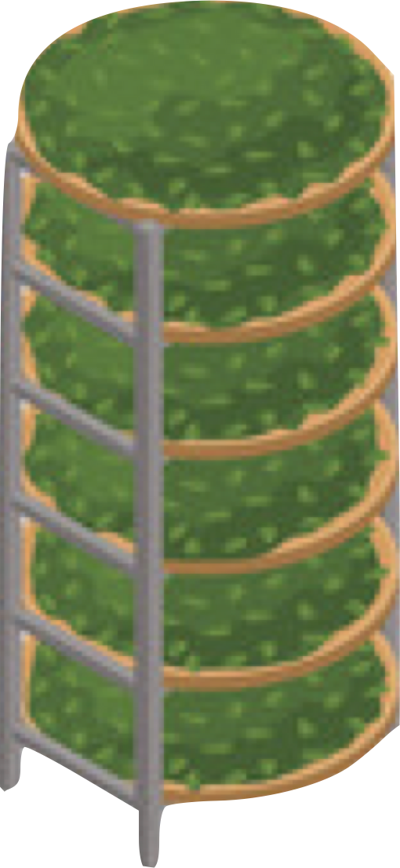
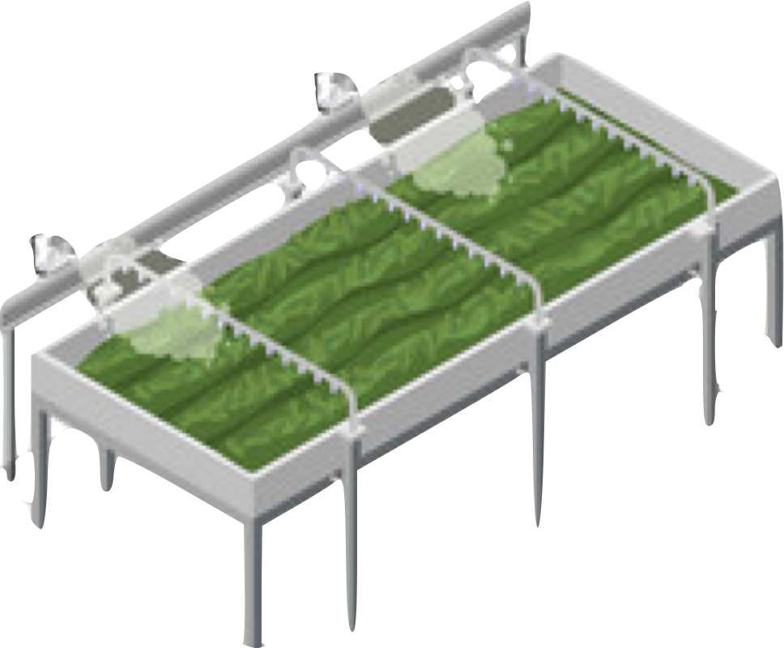
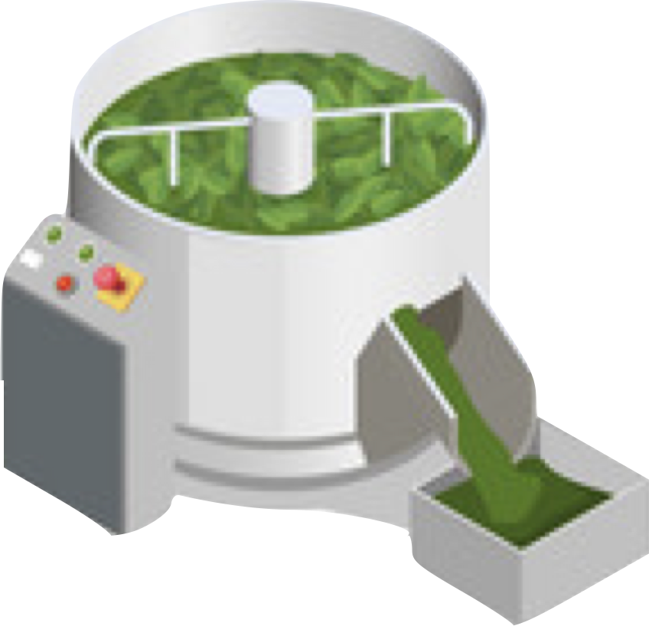

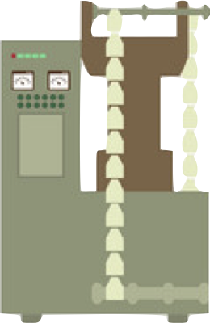



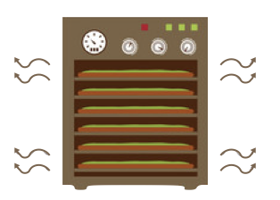

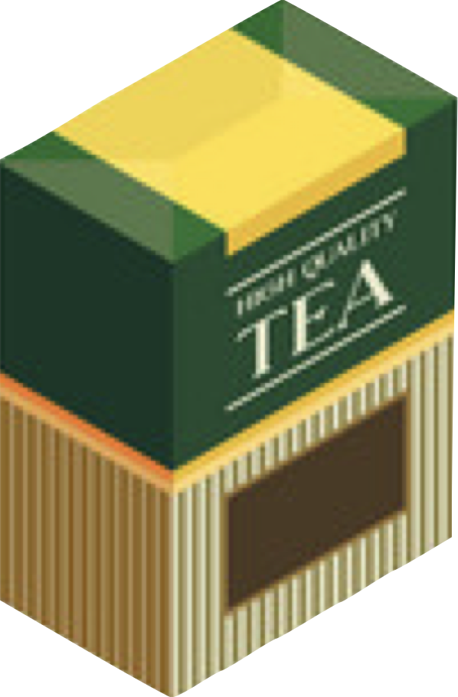
Leaves are withered to prepare the leaves for further processing by reducing their moisture content. This allows for the development of aroma and flavour compounds in the leaves.
Leaves are shaped which causes essential oils and juices inside the leaves to ooze out, which further enhances the taste of the tea.
Leaves are separated according to the particle size using sieves, and then tea is cleaned by removing any dust.
Fermentation affects the smell of the tea and typically mellows its taste, reducing bitterness while improving mouthfeel and aftertaste.
Rolling causes the cell walls of the leaf to break down, releasing the enzymes and essential oils that will alter the flavour of the leaf.
Packaging protects the tea aroma and quality, as well as looking appealing for the customer.
Leaves are pre- dried for the next steps in production.
This process gives mildly roasted
flavours with more sweet and fresh notes than bitter ones.
Drying makes the tea leaves stable and enhances the flavour.
Leaves are rolled like Black and oolong tea.
Leaves are dried to take out moisture, ready for…
The bud leaves are only dried.
REPEAT
HARVERSTING
Black & Oolong Tea
1. Withering
2. Rolling
3. Fermentation
4. Drying
5. Sorting
White Tea
1. Pan-Fry Or Steaming
2. Pre-Dry
3. Rolling
4. Post-Dry
5. Shaping
From these different processes, they produce teas with organic and unique flavour profiles, with different strength intensities.
Green Tea
1. Drying (Bud Only)
Packaging

Slide 8
Leaves are withered to prepare the leaves for further processing by reducing their moisture content. This allows for the development of aroma and flavour compounds in the leaves.
Leaves are shaped which causes essential oils and juices inside the leaves to ooze out, which further enhances the taste of the tea.
Leaves are separated according to the particle size using sieves, and then tea is cleaned by removing any dust.
Fermentation affects the smell of the tea and typically mellows its taste, reducing bitterness while improving mouthfeel and aftertaste.
Rolling causes the cell walls of the leaf to break down, releasing the enzymes and essential oils that will alter the flavour of the leaf.
Packaging protects the tea aroma and quality, as well as looking appealing for the customer.
Leaves are pre- dried for the next steps in production.
This process gives mildly roasted
flavours with more sweet and fresh notes than bitter ones.
Drying makes the tea leaves stable and enhances the flavour.
Leaves are rolled like Black and oolong tea.
Leaves are dried to take out moisture, ready for…
The bud leaves are only dried.
HARVERSTING
Black & Oolong Tea
1. Withering
2. Rolling
3. Fermentation
4. Drying
5. Sorting
White Tea
1. Pan-Fry Or Steaming
2. Pre-Dry
3. Rolling
4. Post-Dry
5. Shaping
From these different processes, they produce teas with organic and unique flavour profiles, with different strength intensities.
Green Tea
1. Drying (Bud Only)
Packaging

Slide 9



WHAT DO TEAS TASTE LIKE?

Slide 10





OK, SO ARE THERE ANY HEALTH BENEFITS?
White tea - Antioxidants are found in this tea which promote heart health and strength by lowering bad cholesterol levels and strengthening blood vessels. Silver Needle White Tea may also aid in preventing blood clots that are responsible for heart attacks and strokes.
Teas all have their unique style of flavour, along with appearance, aroma, flavour and mouth feel.
Milk and sugar are common additions to teas, however they do alter the flavour, therefore many prefer the raw taste of the tea.
Green tea – Green tea has been shown to improve blood flow and lower cholesterol. A 2013 review of many studies found green tea helped prevent a range of heart-related issues, from high blood pressure to congestive heart failure.
WHITE TEA
OOLONG TEA
GREEN TEA
BLACK TEA
Oolong tea – Oolong has benefits for the heart, brain, bone and dental health. In addition, it may boost your metabolism, decrease your risk of developing type 2 diabetes and protect against certain types of cancer.
Mellow, floral and refreshing. Silver needle is a popular tea leaf in this particular category.
varies wildly in flavour due to their wide range of
oxidation levels. Common tasting notes are: floral, sweet & toasty.
Vegetal and grassy notes. Matcha is a popular powdered by-product, used in many ways.
Dark and malty flavour. Generally stronger than other teas. English Breakfast is a popular blend of this category.
Black Tea - Nutrients in black tea may reduce the risk of several cancers protect the heart against atherosclerosis, and help maintain healthy blood pressure.

Slide 11
ALUMINIUM
OXALATES
ALUMINIUM IS ALSO FOUND IN TEA. LARGE DOSES CAN BE TOXIC
TEA CONTAINS OXOLATE, OVER CONSUMPTION COULD CAUSE KIDNEY STONES
2
4
1
3
5
FLUORIDE
CAFFIENE
TEMPERATURE
FLUORIDE IS PRESENT IN TEA. FLUORIDE INCREASES THE RISK OF OSTEOPOROSIS AND FRACTURES
CAFFIENE IS COMMON IN TEA. IT ELEVATES YOUR HEART RATE, INCREASES BLOOD FLOW, BLOOD SUGAR LEVELS AND ACTS AS AN DIURETIC
DRINKING HOT BEVERAGES REGULARLY CAN DAMAGE THE TISUE IN YOUR ESOPHAGUS

Slide 12
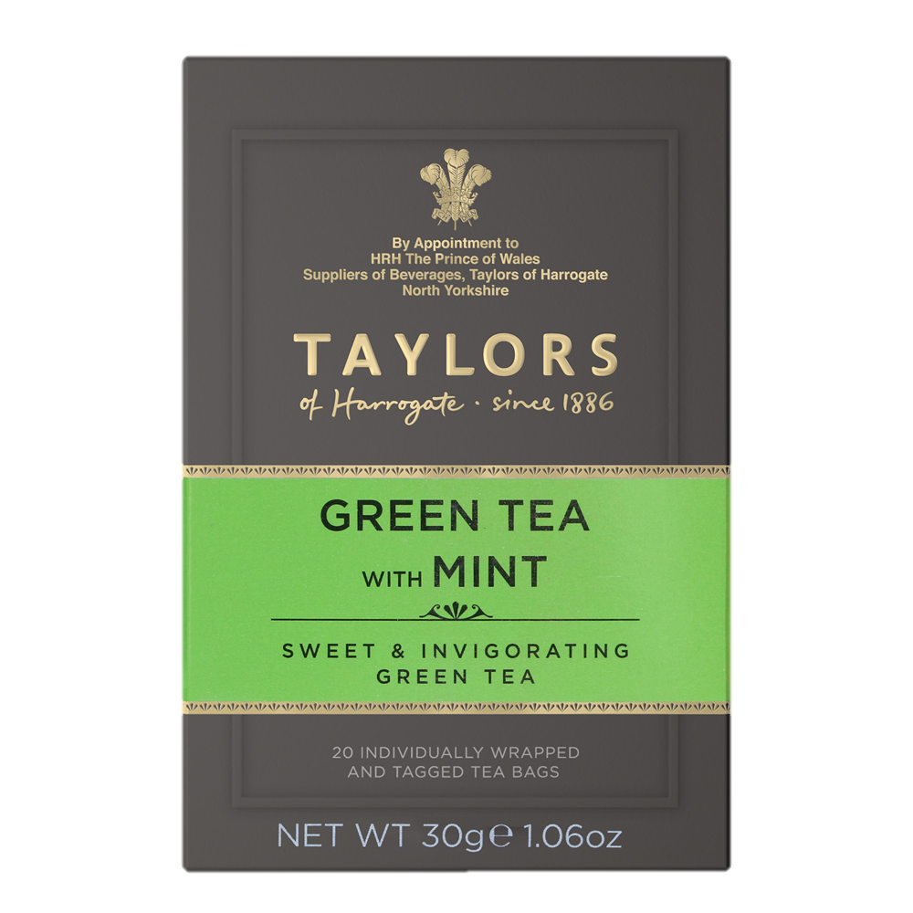
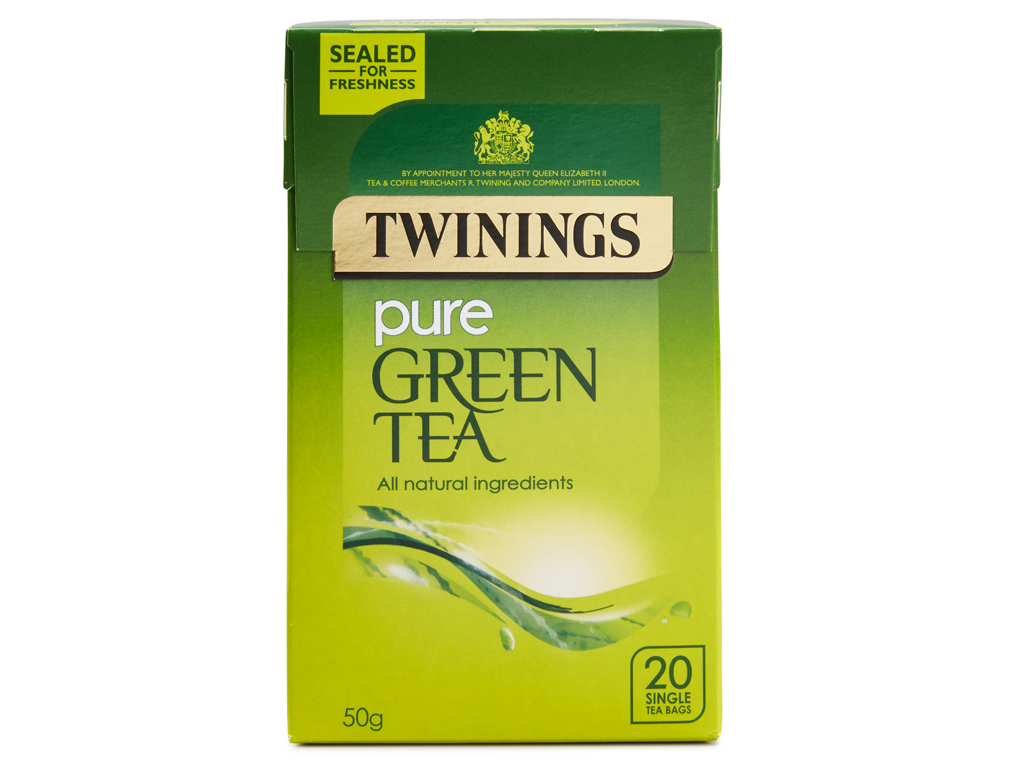

CAN YOU THINK OF ANY POPULAR TEA BRANDS?
Here are a few:

Slide 13
SUMMARY OF TEA MODULE
What is the History Behind it?
Are there any health benefits?
Finally, where is tea made?
What is Tea?
What are the processes?

